Slide 1
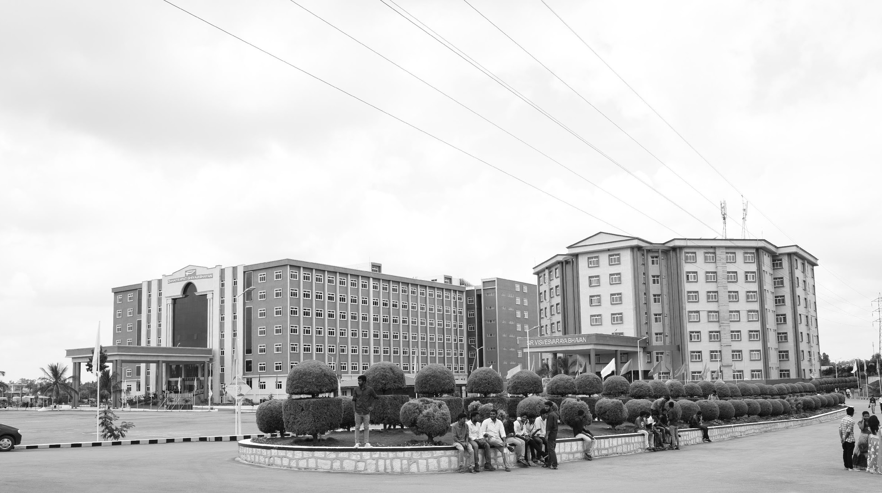

Image Enhancement Approaches for Improved Visual Quality and Analysis
Review-I
AY 2025-26
Capstone Project – Introduction (PROJ2999)
GITAM (Deemed-to-be) University
Department of Electrical Electronics and Communication Engineering
Project Team:
Meruga Sanjana
Starow Cynthia
Project Mentor:
Dr. Ajay kumar Mandava
Project In-charge:
Kshitij shakay
www.gitam.edu

Slide 2
Objective and Goals
Objective
Improve images degraded by noise, low contrast, haze, or poor illumination
Implement and assess image enhancement techniques (spatial and transform domain).
Enhance brightness, contrast, sharpness, and color fidelity.
Goals
Main Goals
Restore clarity and essential details in images.
Achieve notable improvements in overall image quality.
Provide a strong basis for subsequent tasks such as segmentation, feature extraction, and image stitching.
Additional Goals
Extend applications to medical imaging, remote sensing, surveillance, and photography.
Improve both human perception and automated analysis of images.

Slide 3
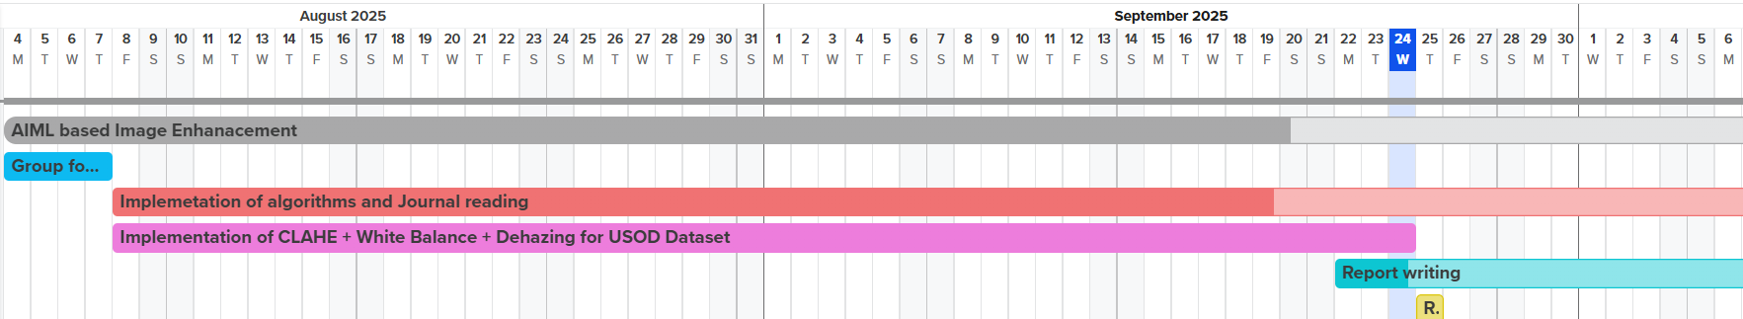
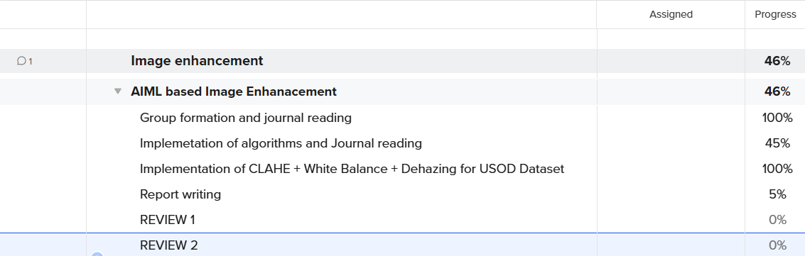
Project Plan (Clearly mention milestone for objectives under each reviews)

Slide 4
Literature Survey
Key Publications
Qi, Y., Yang, Z., Sun, W., Lou, M., Lian, J., Zhao, W., Deng, X., & Ma, Y. (2022). A comprehensive overview of image enhancement techniques. Archives of Computational Methods in Engineering, 29, 583–607. https://doi.org/10.1007/s11831-021-09587-6
Raveendran, S., Patil, M. D., & Birajdar, G. K. (2021). Underwater image enhancement: A comprehensive review, recent trends, challenges and applications. Artificial Intelligence Review, 54(7), 5413-5467. https://doi.org/10.1007/s10462-021-10025-z.
Singh, N., & Bhat, A. (2023). A systematic review of the methodologies for the processing and enhancement of the underwater images. Multimedia Tools and Applications, 82, 38371-38396. https://doi.org/10.1007/s11042-023-15156-9
Verma, G. (2022). Systematic review and analysis on underwater image enhancement methods, datasets, and evaluation metrics. Journal of Electronic Imaging, 31(6), 060901. https://doi.org/10.1117/1.JEI.31.6.060901.
Almutiry, O., Iqbal, K., Hussain, S., Mahmood, A., & Dhahri, H. (2021). Underwater images contrast enhancement and its challenges: A survey. Multimedia Tools and Applications. https://doi.org/10.1007/s11042-021-10626-4
Key Resources – Whitepaper| Application Notes | Datasheet| Others
A Novel Fast Single Image Dehazing Algorithm Based on Artificial Multiexposure Image Fusion
A Low Power and Low Complexity Automatic White Balance Algorithm for AMOLED Driving Using Histogram Matching
Low Contrast Enhancement Algorithm for Color Image Using Pythagorean Fuzzy Sets With a Fusion of CLAHE and BPDHE Methods
Existing Implementations – Products| Opensource| GitHub etc
Dual-Scale Single Image Dehazing via Neural Augmentation
Automatic white balance for digital still camera
Research on Histogram Equalization Algorithm Based on Optimized Adaptive Quadruple Segmentation and Cropping of Underwater Image (AQSCHE)

Slide 5
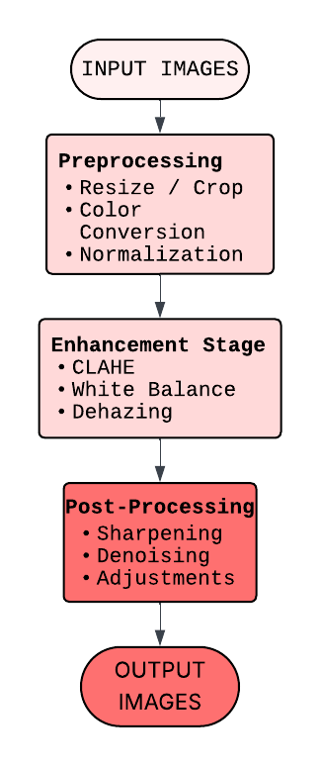
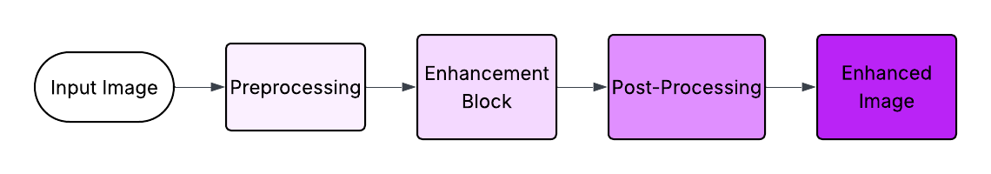
Architecture
Behaviour Diagram
Structural Diagram

Slide 6
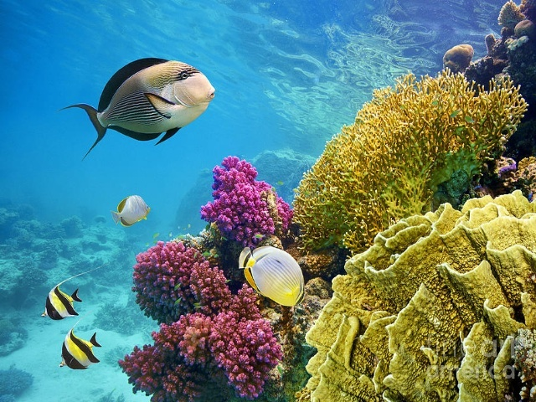
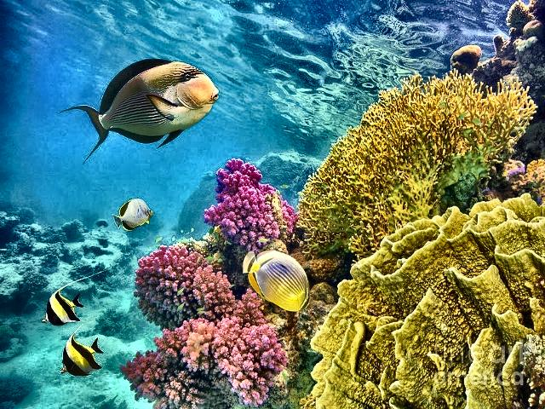
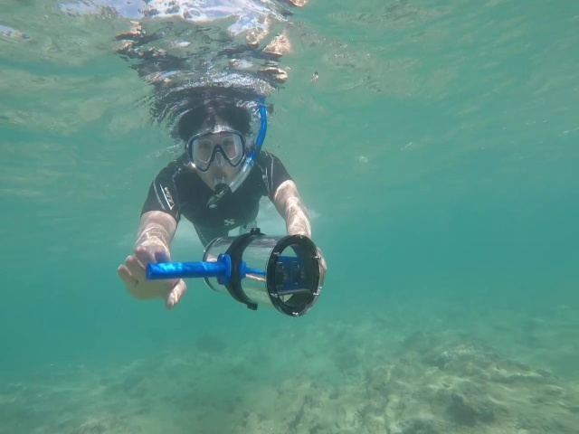
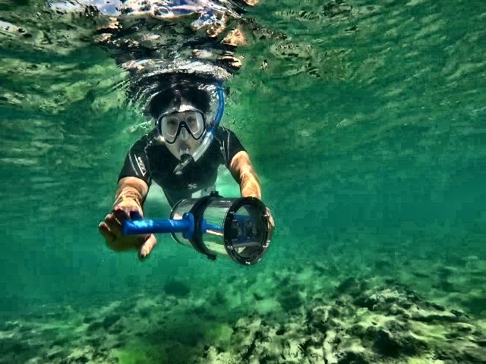
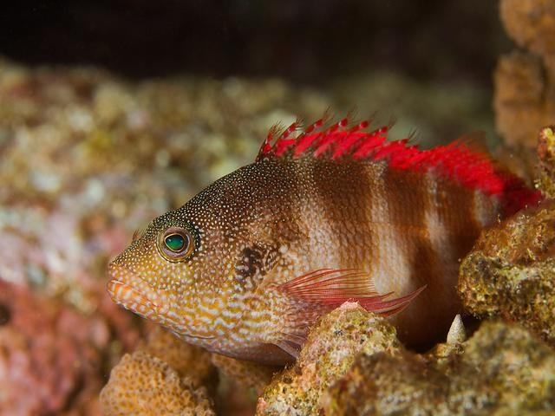
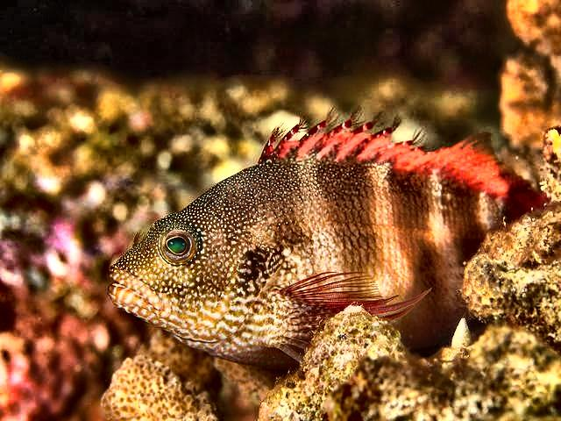
Use Cases & Testing
ORIGINAL IMAGE ENHANCED IMAGE
ORIGINAL IMAGE ENHANCED IMAGE
ORIGINAL IMAGE ENHANCED IMAGE

Slide 7
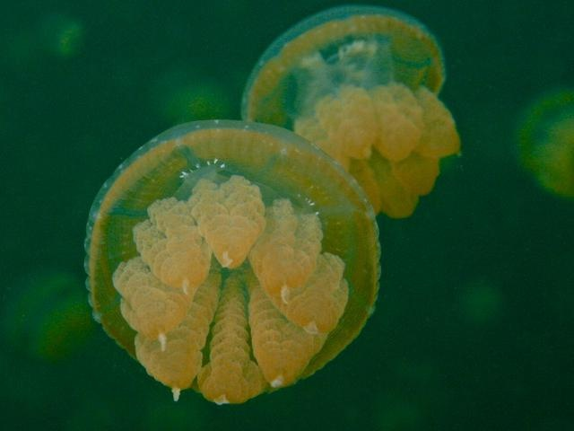
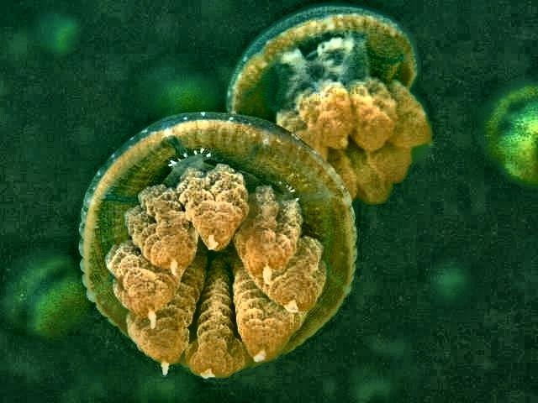
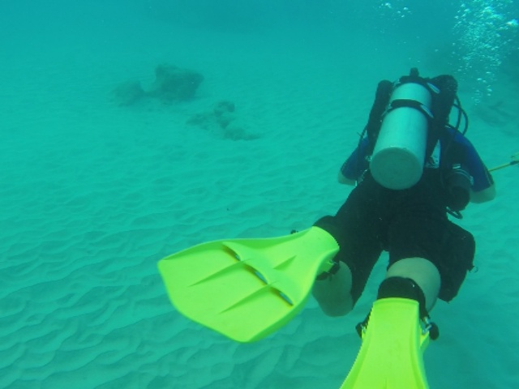
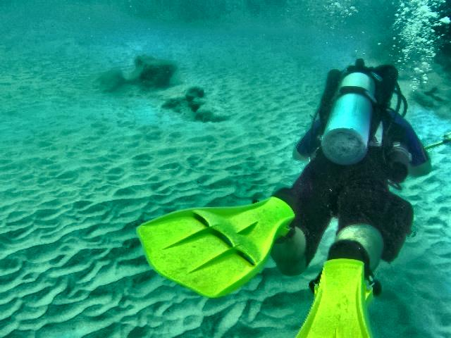
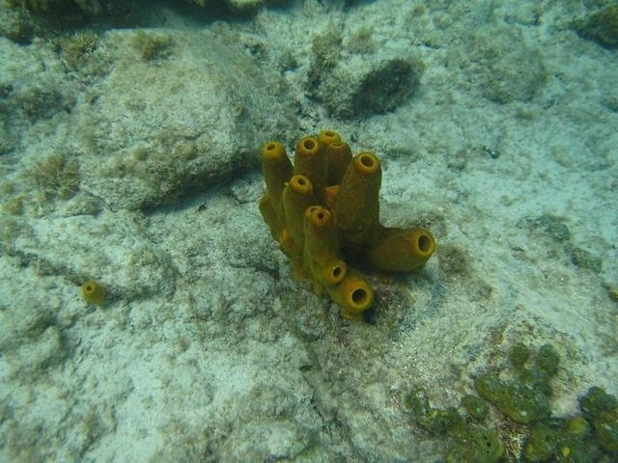
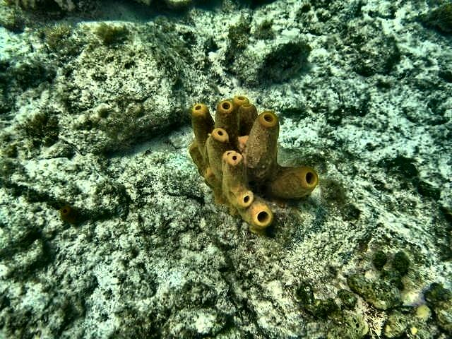
Implementation and Results – Iteration 1
ORIGINAL IMAGE ENHANCED IMAGE
ORIGINAL IMAGE ENHANCED IMAGE
ORIGINAL IMAGE ENHANCED IMAGE

Slide 8
Conclusion & Future Work
Summary and Conclusion
A MATLAB-based image enhancement pipeline was developed using techniques such as CLAHE, White Balance, and Dehazing to improve contrast, brightness, sharpness, and color fidelity. The implemented methods effectively restored clarity and essential details, demonstrating notable improvements in overall image quality. The modular design allowed efficient processing and flexible parameter tuning, providing a strong foundation for subsequent tasks such as segmentation, feature extraction, and stitching.
Limitations include the potential for over-enhancement, reliance on parameter selection, and the absence of absolute ground truth for quantitative evaluation.
Future Work
Explore multi-layer decomposition (base/detail layers) for selective enhancement, minimizing artifacts while preserving essential image features.
Integrate deep learning models (CNNs, GANs, Transformers) for adaptive and environment-specific enhancement.
Optimize enhancement pipelines to improve perceptual quality and support downstream tasks, including medical imaging, remote sensing, surveillance, and automated analysis.

Slide 9
THANK YOU
Have a Great Day !

